Slide 2



Grazie ai nostri sponsor

Slide 3

Welcome Azure Functions 2.0
Massimo Bonanni
Paranormal Developer, with the head in the Cloud and all the REST in microservices

Slide 4


Serverless is to servers as wireless is to wired. Wireless internet still requires wires, but customers don't need to interact with them!!

Slide 5


What is serverless?
Full abstraction of servers
Developers can just focus on their code—there are no distractions around server management, capacity planning, or availability.
Instant, event-driven scalability
Application components react to events and triggers in near real-time with virtually unlimited scalability; compute resources are used as needed.
Pay-per-use
Only pay for what you use: billing is typically calculated on the number of function calls, code execution time, and memory used.*

Slide 6
FaaS is at the center of serverless
Functions-as-a-Service programming model use functions to achieve true serverless compute
Single responsibility
Functions are single-purposed, reusable pieces of code that process an input and return a result
Short lived
Functions don’t stick around when finished executing, freeing up resources for further executions
Stateless
Functions don’t hold any persistent state and don’t rely on the state of any other processes
Event driven & scalable
Functions respond to predefined events, and are instantly replicated as many times as needed

Slide 7








Full integration with Azure ecosystem Functions is the center piece of the Serverless platform
Development
Platform
IDE support
Event Grid
Functions
Logic Apps
Manage all events that can trigger code or logic
Execute your code based on events you specify
Design workflows and orchestrate processes
Integrated DevOps
Local development
Monitoring
Database
Storage
Analytics
Intelligence
Security
IoT
Visual debug history

Slide 8









What are Azure Functions?
Events
Code
Outputs
React to timers, HTTP, or events from your favorite Azure services, with more on the way
Author functions in C#, F#, Node.JS, Java, and more
Send results to an ever-growing collection of services

Slide 9


What can I do with Azure Functions?
Azure Functions is a great solution for processing data, integrating systems, working with the internet-of-things (IoT), and building simple APIs.
Azure Functions supports:
Triggers, which are ways to start execution of your code (timer, http calls, item in a queue,…)
Bindings, which are ways to simplify coding for input and output data (queue, blob storage, CosmosDB, SendGrid)

Slide 10
What’s new in 2.0?
Updated runtime built on .NET Core 2.1
New extensibility model.
.NET Functions loading changes
Run code from a package
Tooling updates: CLI, Visual Studio & VS Code
Durable Functions (GA)
Improvements to DevOps integration
Decoupled from language providers and bindings

Slide 11
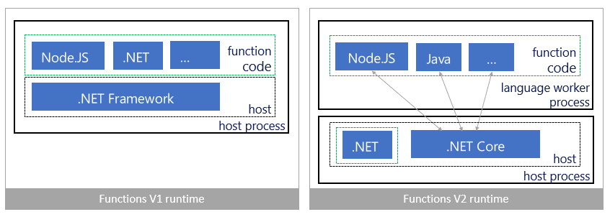
Architecture
.Net Core 2.1 (more performance + cross platform).
Language worker process is out of host process.
All bindings are brought in as extensions.

Slide 12
How much do they cost?
1,000,000 executions
400,000 GB-s
Consumption Plan
Pay only when your functions are running.
App Sevice Plan
You won't pay more than the cost of the VM instance that you allocate.
Supports Linux hosting.
Function execution times out after a configurable period of time
Scale out automatically, even during periods of high load.
You can manually scale out by adding more VM instances, or you can enable autoscale.
You must enable AlwaysOn.

Slide 13
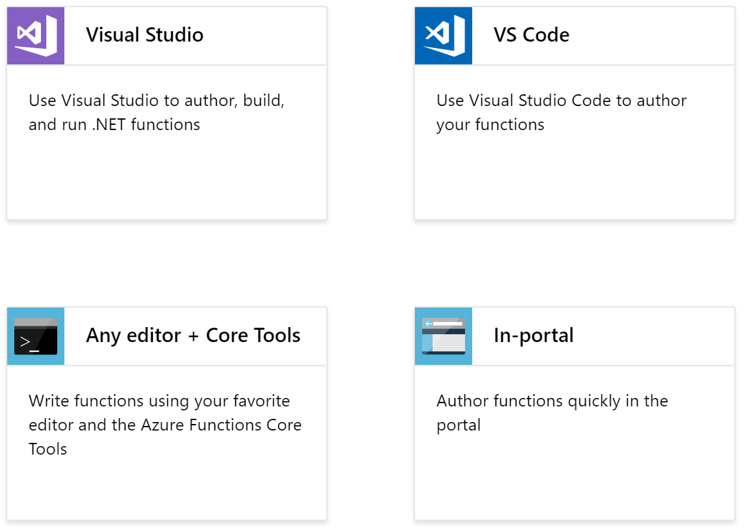
Developer tools

Slide 14
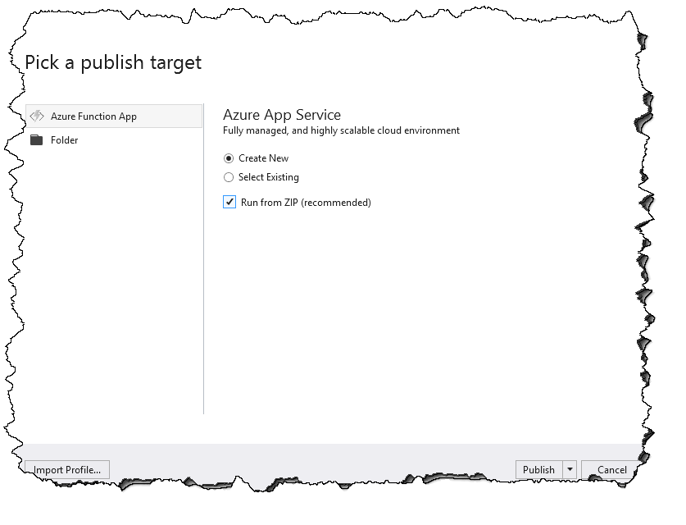
Run functions from a package
In Azure, you can run your functions directly from a deployment package file in your function app.
Reduces the risk of file copy locking issues.
Can be deployed to a production app (with restart).
You can be certain of the files that are running in your app.
Improves the performance of Azure Resource Manager deployments.
May reduce cold-start times, particularly for JavaScript functions with large npm package trees.

Slide 15
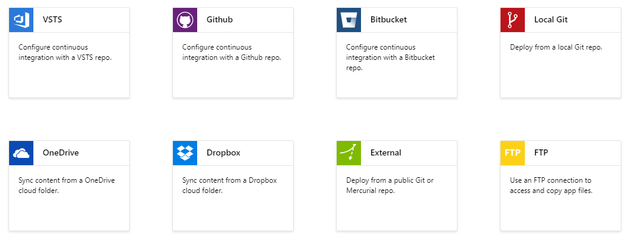
Azure Functions Y DevOps
CI and CD are fully integrated into the Azure Portal.
Azure DevOps Pipeline supports Azure Functions with Package Deploy.

Slide 16
Hello “serverless” world
Notes:
Steps:
Creation of a Function App and explanation of what is Function App
Creation of a HTTP trigger function and explanation of its structure
Test of the HTTP Trigger function
Creation of a new Functions project

Slide 17
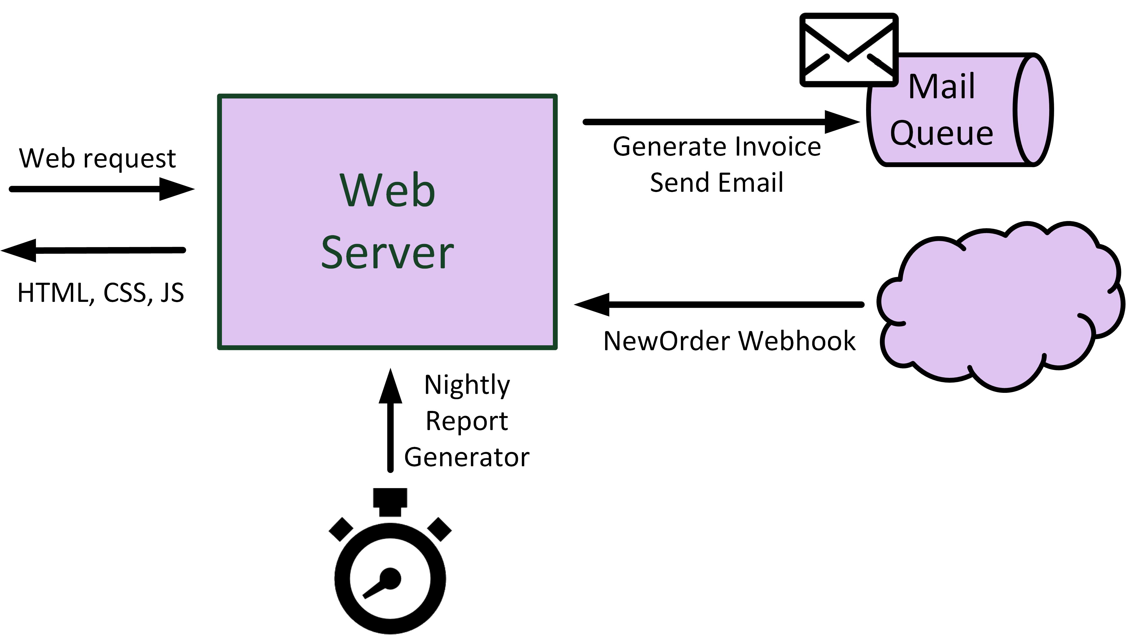
A real-world scenario

Slide 18
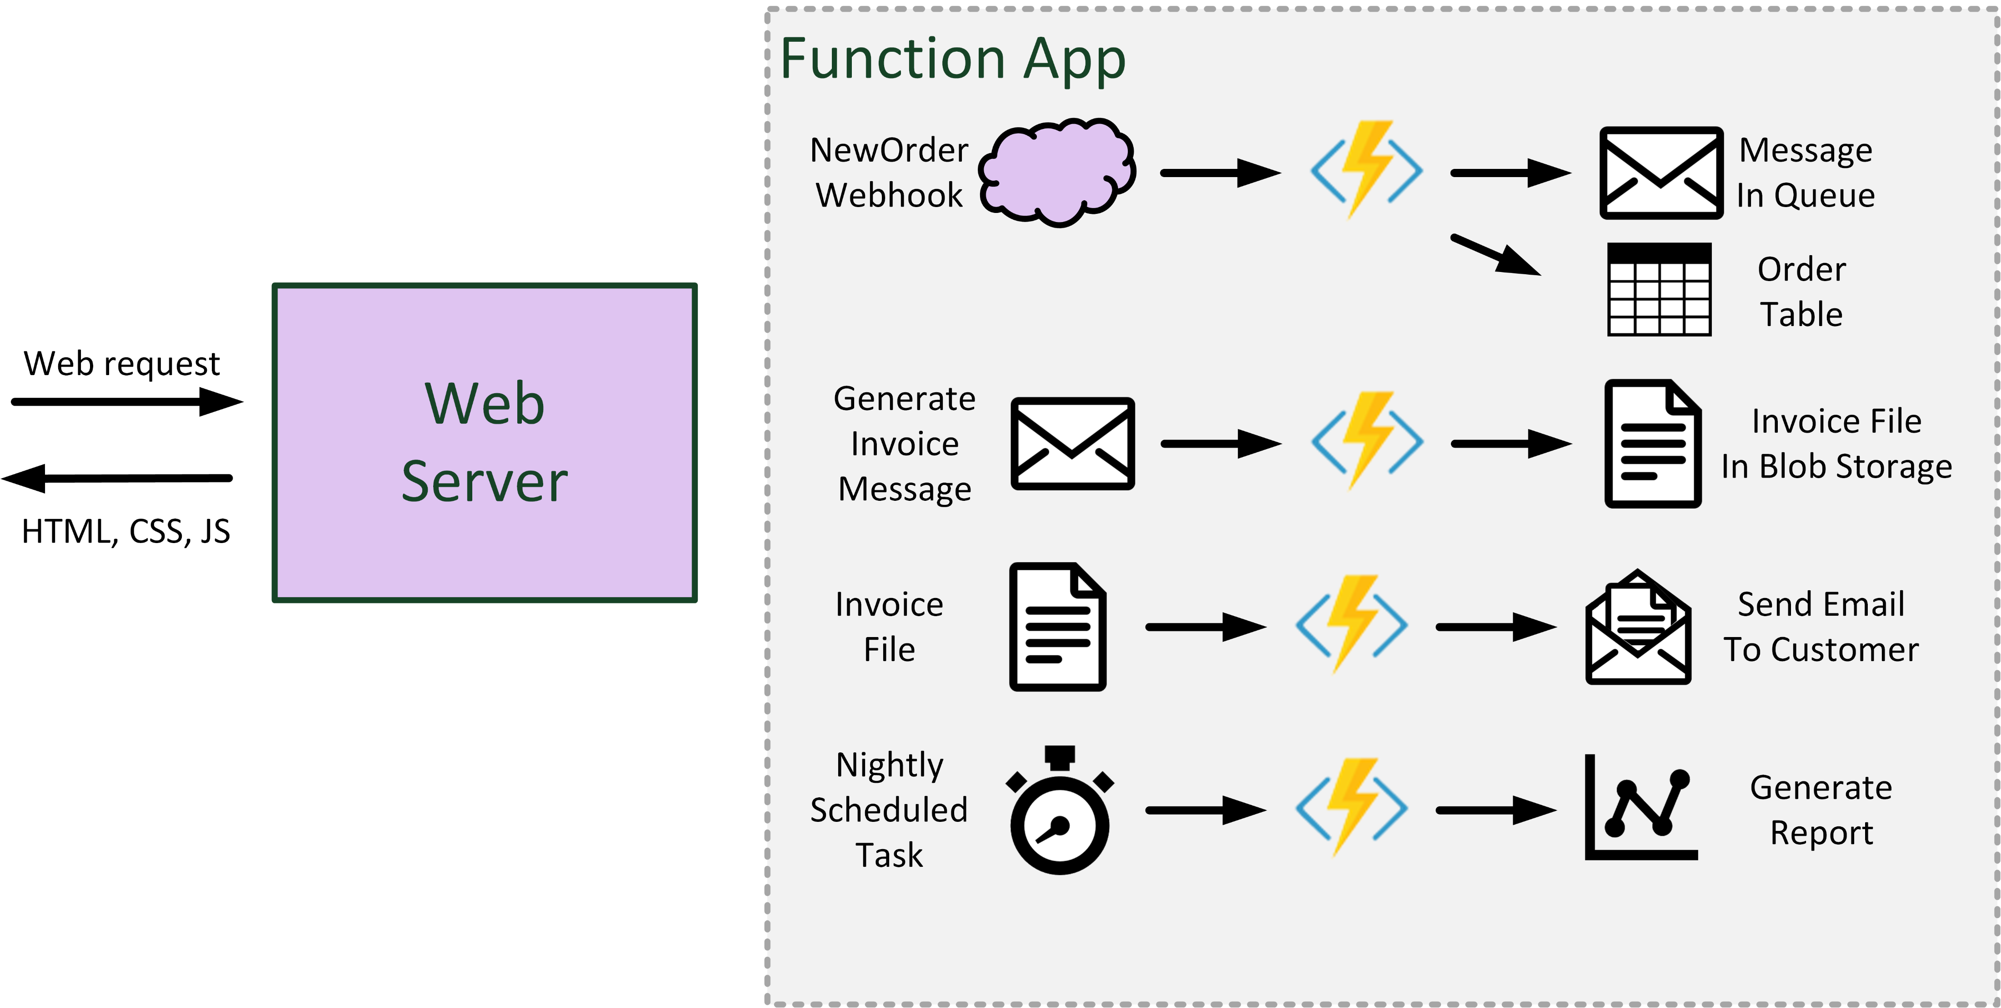
A real-world scenario – Azure Functions

Slide 19
Order Manager Serverless
Notes:
Steps:
Show the solution AorderManagerServerless
Local test
Publish on Azure
Remote test

Slide 20
Best Practices
Avoid long running functions
Use external services for function communication
Write functions to be stateless
Write defensive functions
Don't mix test and production code in the same function app
Use async code but avoid blocking calls

Slide 21


Thanks for your
attention!!!!!
Massimo Bonanni
massimo.bonanni@microsoft.com @massimobonanni https://www.linkedin.com/in/massimobonanni/

Slide 22

Resources
Azure Functions Documentation https://docs.microsoft.com/en-US/azure/azure-functions/
Azure Functions Code Samples https://azure.microsoft.com/en-us/resources/samples/?service=functions&sort=0
Azure Updates https://azure.microsoft.com/en-us/roadmap/?category=compute
Demo – GitHub https://github.com/DotNetToscana/DotNetConf2018 --> Azure Functions 2.0
Video
Serverless architecture in Microsoft Azure https://azure.microsoft.com/en-us/resources/videos/ignite-2018-serverless-architecture-in-microsoft-azure/
Azure Functions internals https://azure.microsoft.com/en-us/resources/videos/ignite-2018-azure-functions-internals/

